Slide 1
Observatory Control
Input file
The SW permits to control by a set of command stored in an Input File:
the mount
the CCD
the dome
The block diagram show the interactions between software, hardware and the relative abstraction layer.
Observatory Control
Computer
ASCOM
MaxIm DL
Telescope Mount
CCD
Dome

Slide 2
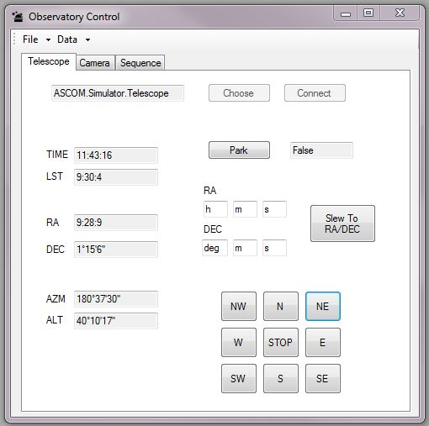
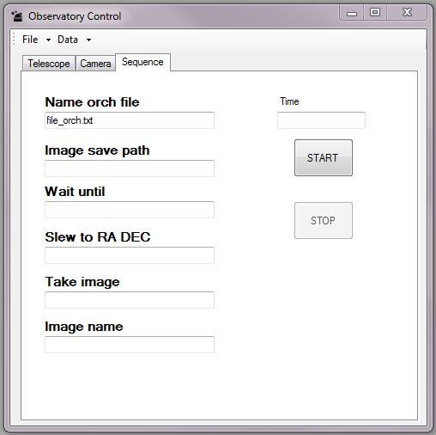
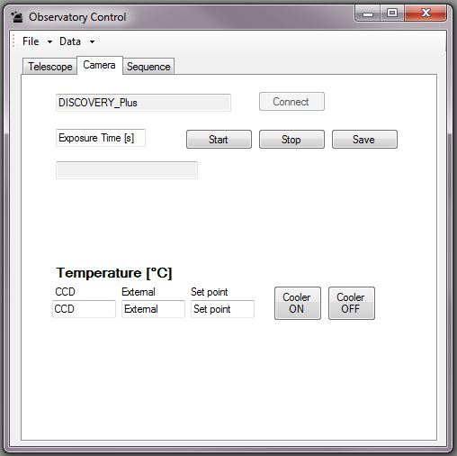
Observatory Control: tabs and functionality
Tab Telescope: Choose, Connect, Move, Park and show data position of the Telescope.
Tab Sequence: Start, Stop and show the command sequence, select the observatory.
Tab Camera: Choose, Connect, set temperature of the CCD, take and save picture.
Tab Dome: open, closed and query the dome.
Mettere foto del tab dome

